Slide 1
Langgraph
Ali Khawaja
Microsoft Arabia
Notes:
Welcome to the LangGraph module. LangGraph is an open-source framework built by LangChain Inc that models AI workflows as graphs rather than chains. This is a fundamental shift in how we think about building AI applications — instead of linear pipelines, we now have stateful, multi-step, multi-actor architectures.
Key message: LangGraph gives us the low-level control to build sophisticated agent systems that can loop, branch, persist state, and coordinate multiple actors.

Slide 2
Langgraph
Open source library authored by LangChain
LangGraph was designed to enable developers to implement:
Multiactor
Multistep
Stateful
Cognitive architectures
LangGraph models AI workflows as a graph instead of a chain.
Notes:
LangGraph was purpose-built for cognitive architectures — systems where an LLM doesn't just answer questions but reasons, plans, and acts over multiple steps.
The four pillars:
- Multiactor: Multiple LLMs or agents collaborating
- Multistep: Complex workflows that require several rounds of processing
- Stateful: State persists across steps, enabling memory and context
- Cognitive architectures: Systems that can reason, plan, and adapt
The key insight is that a chain (A→B→C) is too rigid for real agent workflows. Agents need to loop back, branch conditionally, and make decisions at runtime. A graph naturally models this.

Slide 3
Langgraph (cont…)
LangGraph is a low-level orchestration framework and runtime for building, managing, and deploying long-running, stateful agents.
Very low-level, and focused entirely on agent orchestration!
You don’t need to use LangChain to use LangGraph
Use LangChain’s agents that provide prebuilt architectures for common LLM and tool-calling loops.
LangGraph is built by LangChain Inc, the creators of LangChain, but can be used without LangChain.
Notes:
Important distinction: LangGraph is the orchestration layer, NOT the agent logic itself. Think of it as the 'operating system' for agents.
LangChain provides higher-level agent abstractions (like create_react_agent) that are built ON TOP of LangGraph. You can use LangGraph without LangChain — it's framework-agnostic.
The official docs describe LangGraph as: 'A low-level orchestration framework and runtime for building, managing, and deploying long-running, stateful agents.' The emphasis on 'long-running' is critical — this isn't just for quick request-response; it's for agents that may run for minutes or hours, maintaining state throughout.

Slide 4
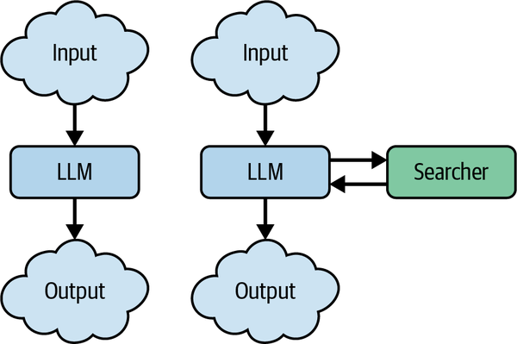
Langgraph - Multiactor
A team of specialists can build something together that none of them could build alone.
Similarly, an LLM prompt is much more powerful when paired up with related artifacts:
Prompts
Tools
Agents
MCP Servers, etc.
Notes:
The multiactor concept is central to modern AI systems. Just as a software team has frontend developers, backend developers, and QA engineers, an AI system can have specialist agents.
Each actor brings different capabilities:
- Different prompts optimize for different tasks
- Different tools give access to different data sources
- Different models can be used (e.g., a fast model for routing, a powerful model for reasoning)
- MCP servers provide standardized tool interfaces
The power comes from composition — a research agent paired with a writing agent can produce better content than either alone. This is the foundation for the multi-agent patterns we'll explore later.

Slide 5
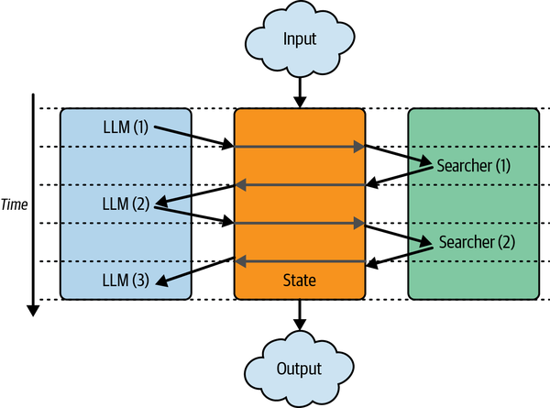
Actor coordination
An application with multiple actors needs a coordination layer to manage the following:
Define the actors involved (the nodes in a graph), and
How they hand off work to each other (the edges in that graph)
Schedule execution of each actor
With a single central state, we can:
Snapshot and store the central state during or after each computation.
Pause and resume execution, which makes it easy to recover from errors.
Implement human-in-the-loop controls
Notes:
This slide introduces the three foundational concepts that LangGraph provides for coordination:
1. GRAPH STRUCTURE: Nodes are the actors (Python functions), edges define how work flows between them. This is a Directed Acyclic Graph (DAG) — though with conditional edges, we can create cycles (loops).
2. CENTRAL STATE: All actors read from and write to a single shared state object. This eliminates the need for message-passing between actors. The state is the 'single source of truth.'
3. PERSISTENCE: By snapshotting state at each step, we get:
- Error recovery: Resume from last good state
- Human-in-the-loop: Pause, let a human review, then continue
- Time-travel debugging: Inspect or replay any past state
These three capabilities — graph structure, central state, and persistence — are what make LangGraph uniquely powerful for building production agent systems.

Slide 6
Graph in langgraph (DAG!)
Each graph is then made up of the following:
State
The data received from outside the application, modified and produced by the application while it’s running.
Nodes
Each step to be taken. Nodes are simply Python/JS functions (tools), which receive the current state as input and can return an update to that state (that is, they can add to it and modify or remove existing data).
Edges
The connections between nodes. Edges determine the path taken from the first node to the last, and they can be either:
fixed (that is, after Node B, always visit node D) or
conditional (evaluate a function to decide the next node to visit after node C).
Notes:
Let's formalize the three building blocks:
STATE: A TypedDict (or Pydantic model) that defines the shape of data flowing through the graph. Every node receives the current state and returns updates to it. State is NOT replaced — it's merged according to reducer functions.
NODES: Pure Python functions. They take state as input and return a dict of state updates. Nodes can call LLMs, execute tools, perform calculations — anything. The key insight: nodes are NOT limited to LLM calls.
EDGES: Two types:
- Fixed edges: Deterministic flow (always go from A to B)
- Conditional edges: A Python function examines the current state and returns which node to visit next. This is what enables branching and looping.
The DAG structure means there's always a clear entry point (START) and exit point (END), with well-defined paths between them.

Slide 7
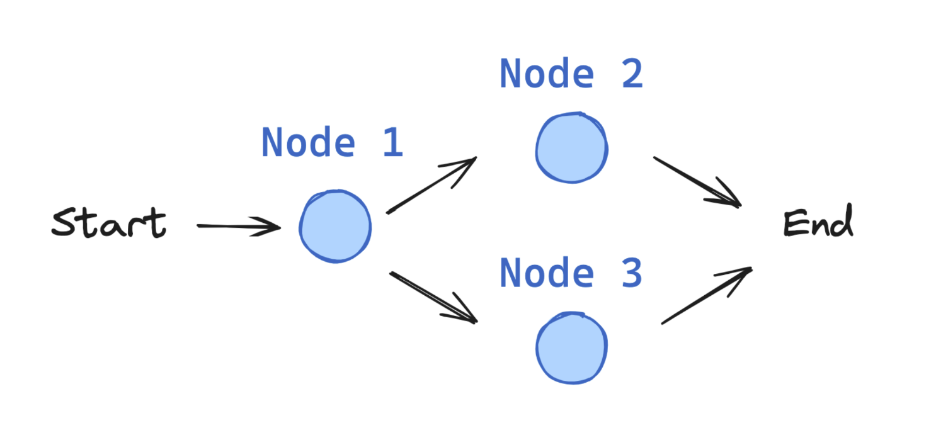
Implementing a basic graph
Notes:
This is a transition slide into our first hands-on demo. We'll build a simple graph step by step to see how all three building blocks (state, nodes, edges) come together.
Refer to notebook: 1.hello_world.ipynb — this shows the absolute minimal graph with two nodes connected by a fixed edge.
Then we'll move to 2.simple_graph.ipynb which adds conditional edges for branching logic.

Slide 8
Graph building blocks
Graph state (object to hold state of the workflow/graph)
Nodes (python functions)
Edges (node connection)
Holds logic to control the flow
Normal Edges: Always go from point A → point B
Conditional Edge: Logic (some python function) to decide which path to take!
Not really an edge!
START/END Nodes: Special nodes indicating start and end of the graph
Compile the graph (and optionally display to verify the structure is as intended!)
Notes:
Let's walk through the code patterns:
StateGraph(State): Creates a graph builder with a specific state schema. The State is a TypedDict that defines what data the graph tracks.
add_node('name', function): Registers a Python function as a node. The function receives the full state and returns a dict of updates.
add_edge(A, B): Fixed edge — always go from A to B after A completes.
add_conditional_edges(A, router_fn): The router function examines state and returns a string naming the next node. This is how we implement branching logic.
START and END are special sentinel nodes — START is the entry point, END terminates the graph.
compile(): Converts the builder into a runnable graph. This is when LangGraph validates the structure (no orphan nodes, no missing edges, etc.).
The compiled graph has .invoke() for single execution and .stream() for streaming output.

Slide 9
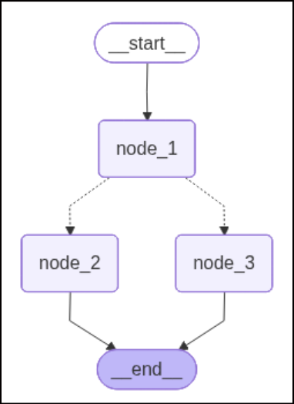
Creating our first graph
# Build graph
builder = StateGraph(State)
builder.add_node("node_1", node_1)
builder.add_node("node_2", node_2)
builder.add_node("node_3", node_3)
# Logic
builder.add_edge(START, "node_1")
builder.add_conditional_edges("node_1", decide_mood)
builder.add_edge("node_2", END)
builder.add_edge("node_3", END)
graph = builder.compile() display(Image(graph.get_graph().draw_mermaid_png()))
Notes:
This code example shows all three types of edges:
1. builder.add_edge(START, 'node_1') — fixed edge from entry to node_1
2. builder.add_conditional_edges('node_1', decide_mood) — conditional edge from node_1
3. builder.add_edge('node_2', END) and builder.add_edge('node_3', END) — fixed edges to exit
The decide_mood function is the router — it returns either 'node_2' or 'node_3' based on some condition (e.g., random choice, state value, LLM decision).
After compile(), we can visualize the graph with draw_mermaid_png() — this generates a diagram showing all nodes and edges, which is invaluable for debugging complex graphs.
Demo: Run 2.simple_graph.ipynb

Slide 10
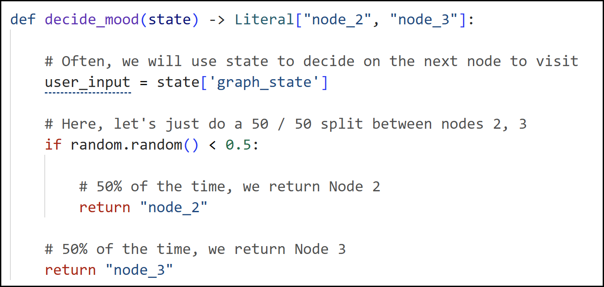
Conditional Edge
Notes:
Conditional edges are what make LangGraph powerful beyond simple chains. The routing function:
- Receives the current state as input
- Returns a string matching a node name
- Can contain ANY Python logic (if/else, LLM calls, ML models, etc.)
Type hints matter: Use Literal['node_a', 'node_b'] as the return type — this helps LangGraph validate the graph structure at compile time and enables accurate visualization.
In practice, conditional edges are used for:
- Tool routing (did the LLM request a tool call?)
- Classification (which specialist should handle this?)
- Loop control (should we continue or stop?)
- Error handling (retry or fail gracefully?)

Slide 11
DEMO (basic graph)
Basic Graph
Notes:
Demo notebooks:
- 1.hello_world.ipynb: Minimal 2-node linear graph
- 2.simple_graph.ipynb: Graph with conditional branching
Key points to demonstrate:
1. Define a TypedDict state with a 'graph_state' string field
2. Create three node functions that modify the state
3. Wire them with fixed edges and one conditional edge
4. Compile and visualize
5. Run multiple times to show the conditional edge taking different paths
Ask students: What happens if the router function returns a node name that doesn't exist? (Answer: LangGraph raises an error at compile time if you use Literal types, or at runtime otherwise.)

Slide 12
Reducers
Reducers define how simultaneous/competing updates are performed by multiple actors!
Imagine a graph with two branches running in parallel:
Branch A produces {"messages": [msgA]}
Branch B produces {"messages": [msgB]}
Both update the same state key: messages, but there are multiple ambiguities:
Should the final state contain only msgA?
only msgB? both?
in what order?
A reducer answers that question deterministically.
Typically defined in the state schema, i.e., in the typed definition of your state
You are basically defining that when multiple updates happen, they should be done in a specific way!
Reducers are crucial for parallelism
Notes:
Reducers solve a fundamental problem: what happens when multiple nodes try to update the same state key?
Without a reducer, the default behavior is LAST WRITE WINS — if Branch A writes messages=[msgA] and Branch B writes messages=[msgB], the final state depends on which branch finishes last. This is non-deterministic and usually wrong.
A reducer provides a deterministic merge function. The most common example is add_messages, which APPENDS new messages to the existing list rather than replacing it.
Think of reducers like database conflict resolution:
- add_messages → append (list concatenation)
- operator.add → sum (for counters)
- Custom → any merge logic you need
Reducers are defined in the state schema using Python's Annotated type: Annotated[list, add_messages] tells LangGraph to use the add_messages reducer for that field.
This is crucial for agent architectures where the message history must grow over time, not be overwritten.

Slide 13
Reducer patterns
Keep all values? → list append / set union
Keep only one authoritative value? → last write wins
Combine partial structured data? → dict merge
Aggregate metrics? → sum/max/min
Example: Message Accumulation
LangGraph lets you define the messages state key with a reducer that concatenates lists.
new_messages = old_messages + node1_messages + node2_messages
Done using the built‑in add_messages reducer
Notes:
Common reducer patterns from the official docs:
1. LIST APPEND (add_messages): Most common. Concatenates message lists. Also handles message updates by ID — if a new message has the same ID as an existing one, it REPLACES that specific message rather than duplicating it.
2. LAST WRITE WINS: Default behavior (no reducer). Good for fields like 'current_step' or 'final_answer' where you only want the latest value.
3. DICT MERGE: For structured metadata that accumulates from different sources.
4. SUM/MAX/MIN: For aggregating metrics across parallel branches.
The add_messages reducer is special — it's not just append. From the docs: 'add_messages merges two lists of messages, updating existing messages by ID.' This means you can correct a previous message by sending an update with the same ID.

Slide 14
DEMO (reducers)
Basic Graph
Notes:
Demo: 3.graph_with_reducers.ipynb
Key demonstrations:
1. Show messages WITHOUT a reducer — state gets overwritten
2. Show messages WITH add_messages reducer — state accumulates
3. Show MessagesState as a convenience class that includes the reducer
MessagesState is defined as:
class MessagesState(TypedDict):
messages: Annotated[list[AnyMessage], add_messages]
This is the most common state schema for conversational agents. Almost every notebook from here on will use it.

Slide 15
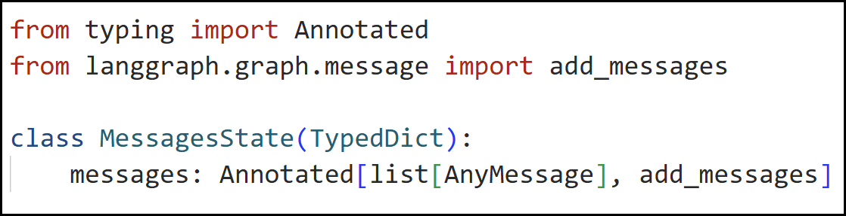
Message reducer
Type | Meaning
messages | The key name in the state dictionary
list[AnyMessage] | The type — a list of LangChain message objects (Human, AI, Tool, etc.)
add_messages | The reducer function — tells LangGraph how to update this key
Annotated[..., ...] | Annotated is from Python's typing module. It lets you attach extra metadata to a type hint without changing the type itself. LangGraph reads that metadata at graph construction time and uses add_messages as the merge strategy whenever a node returns a new value for messages.
Without reducer: messages becomes [new_message] — previous messages are lost.
With add_messages reducer: new_message is appended to the existing list — conversation history is preserved!
Notes:
Two critical behaviors to understand:
WITHOUT REDUCER:
state = {'messages': [msg1, msg2]}
node returns {'messages': [msg3]}
result = {'messages': [msg3]} # LOST msg1 and msg2!
WITH add_messages REDUCER:
state = {'messages': [msg1, msg2]}
node returns {'messages': [msg3]}
result = {'messages': [msg1, msg2, msg3]} # All preserved!
This is why MessagesState exists — to prevent the very common bug of accidentally losing conversation history. Every conversational agent should use it.

Slide 16
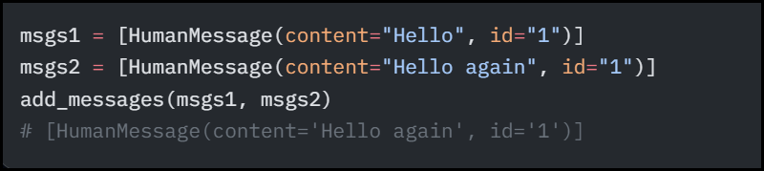
Reducer for Messages: MessageSState
MessagesState is a pre-built conversation-oriented state schema meant to eliminate boilerplate when your graph state is basically “a growing list of messages.”
Under the hood, message accumulation is typically done via the add_messages reducer, which “merges two lists of messages, updating existing messages by ID” and makes the state append-only by default.
BUT, add_messages is NOT just append!
Besiders merging two lists of messages, it also updates existing messages if a new message is provided by an existing ID!
Notes:
MessagesState is a pre-built state class from LangGraph that wraps the most common pattern: a growing list of messages with the add_messages reducer.
Under the hood, add_messages does more than simple append:
1. If a new message has the same ID as an existing message, it UPDATES that message in-place
2. If a new message has a different ID (or no ID), it APPENDS to the list
3. Special handling for RemoveMessage — allows deleting messages from history
This update-by-ID behavior is important for:
- Tool execution: The ToolMessage replaces a pending tool call
- Message editing: Correcting or summarizing previous messages
- Memory management: Removing old messages to fit context windows

Slide 17
Langgraph Helpers
In LangGraph, tools_condition is a prebuilt “routing” (conditional-edge) function used in tool-calling agent loops (ReAct-style). Its whole job is simple:
It looks at the last model (AI) message in your state.
If it contains tool_calls, route to the tools execution node;
Otherwise, end the graph.
tools_condition(state, messages_key="messages") →
Literal["tools", "__end__"]
Returns "tools" when the last message is an AIMessage and has one (or more) tool_calls
Returns "__end__" when there are no tool calls, meaning the agent is ready to respond and the workflow should terminate
Notes:
tools_condition is a prebuilt routing function that implements the most common conditional edge pattern in agent architectures.
How it works:
1. Looks at the LAST message in the state
2. If it's an AIMessage with tool_calls → returns 'tools' (route to tool execution)
3. If it's an AIMessage without tool_calls → returns '__end__' (agent is done)
This replaces 5-10 lines of custom routing code with a single import:
from langgraph.prebuilt import tools_condition
Similarly, ToolNode is a prebuilt node that:
1. Reads tool calls from the last AIMessage
2. Executes each tool
3. Returns ToolMessage results to the state
Together, tools_condition + ToolNode implement the complete tool execution loop with zero custom code.
Demo: 4.tool_calling.ipynb

Slide 18
DEMO (router)
Router Implementation with Langgraph
Notes:
Demo: 5.router.ipynb
The router pattern is the first step toward building agents. The graph structure is:
START → tool_calling_llm → conditional_edge
├→ tools → END (if tool call)
└→ END (if no tool call)
Key insight: The LLM DECIDES the control flow. It either:
- Calls a tool (and we route to the tools node)
- Responds directly (and we end)
This is fundamentally different from traditional programming where control flow is determined by the developer. Here, the LLM is the router.
Compare this to the Agent pattern (next slide) where after tool execution, we route BACK to the LLM instead of ending.

Slide 19
Agents-Like structure
LLM Tool Workflow in Langgraph
Notes:
This diagram shows the key difference between a Router and an Agent:
ROUTER: LLM → tools → END (one-shot tool use)
AGENT: LLM → tools → LLM → tools → LLM → END (loop until done)
The agent can call multiple tools in sequence, using each tool's result to decide what to do next. This is the ReAct (Reason-Act-Observe) pattern:
- Reason: LLM decides what tool to call
- Act: Tool executes
- Observe: LLM sees the result and decides whether to call another tool or respond
The loop continues until the LLM generates a response without tool calls.

Slide 20
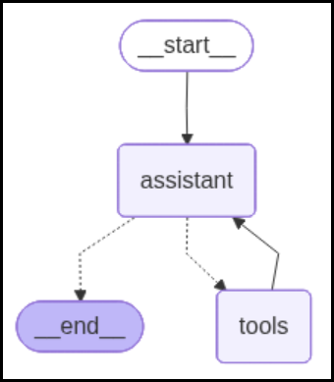
Agents in langgraph
Assistant Node contains our LLM with Tools
Based on invocation, if there is a tool call, tool in invoked, and response is sent to conditional edge
Condition contains tools_condition. If the response is tools, flow is sent to assistant node again.
If not, graph ends!
Notes:
The agent architecture in detail:
1. ASSISTANT NODE: Contains the LLM with bound tools. On each invocation, it receives the full message history (including previous tool results) and decides whether to call another tool or respond.
2. TOOLS NODE: Executes whatever tools the LLM requested. Returns ToolMessage results back to the state.
3. CONDITIONAL EDGE: Uses tools_condition to check if the LLM's response contains tool calls. If yes → route to tools. If no → end.
4. LOOP EDGE: After tools execute, we route BACK to the assistant node. This is what creates the agent loop.
The critical edge is tools → assistant. Without this, we'd have a router (one-shot). With it, we have an agent (multi-step reasoning).
Demo: 6.agent.ipynb

Slide 21
DEMO (Agents)
Langgraph Agents
Notes:
Demo: 6.agent.ipynb
Set up three tools: add, multiply, divide
System message: 'You are a helpful assistant tasked with performing arithmetic.'
Test with: 'Add 3 and 4, then multiply by 2, then divide by 5'
Walk through the execution trace:
1. LLM calls add(3, 4) → 7
2. LLM sees 7, calls multiply(7, 2) → 14
3. LLM sees 14, calls divide(14, 5) → 2.8
4. LLM sees 2.8, responds: 'The result is 2.8'
Each step shows Reason→Act→Observe in action. The agent autonomously decides to stop after getting the final result.

Slide 22
DEMO (Agents with Memory)
Agents with Memory
Notes:
Demo: 7.agent-memory.ipynb
This notebook demonstrates the problem and solution:
WITHOUT MEMORY (no checkpointer):
- Turn 1: 'Add 3 and 4' → 7
- Turn 2: 'Multiply that by 2' → ERROR: 'that' has no referent
WITH MEMORY (MemorySaver checkpointer):
- Turn 1: 'Add 3 and 4' → 7
- Turn 2: 'Multiply that by 2' → 14 (knows 'that' = 7)
The checkpointer saves the full message history at each step, indexed by thread_id. When we invoke with the same thread_id, the agent picks up the conversation where it left off.
config = {'configurable': {'thread_id': '1'}}
Different thread_ids = different conversations. Same thread_id = continued conversation.

Slide 23
subgraphs
Notes:
Subgraphs are a powerful composition primitive that enables modular, scalable agent architectures.
From the official docs: 'A subgraph is a graph that is used as a node in another graph.'
Three key use cases:
1. Multi-agent systems — each agent is a subgraph with its own logic
2. Reusable components — define once, use in multiple parent graphs
3. Distributed development — teams can work on subgraphs independently as long as the interface (input/output schemas) is respected
Think of subgraphs like function calls in programming — they encapsulate complexity behind a clean interface.

Slide 24
subgraphs
A subgraph is simply another graph used as a node inside a larger LangGraph.
In LangGraph, nodes are just functions or components that take state, perform work, and return updated state.
As nodes can be arbitrary functions (not just LLM calls), a compiled graph can also act as a node in another graph, which creates a hierarchical workflow.
Distributing development: Allow your different teams to work on different parts of the graph independently
Notes:
Key concept: A compiled graph IS a callable — it takes state in and returns state out, just like any node function. This means you can use it anywhere a node function is expected.
Two patterns for using subgraphs:
1. ADD AS NODE: When parent and subgraph share state keys, pass the compiled subgraph directly to add_node(). No wrapper needed — state flows through automatically.
2. CALL INSIDE A NODE: When schemas differ, write a wrapper function that maps parent state to subgraph input and maps subgraph output back to parent state.
The choice depends entirely on whether the state schemas are compatible. Shared keys → pattern 1 (simpler). Different keys → pattern 2 (more explicit control).
Demo: 11.subgraphs.ipynb

Slide 25
Subgraph patterns
Pattern | When to use | State schemas
Call a subgraph inside a node | Parent and subgraph have different state schemas (no shared keys), or you need to transform state between them | You write a wrapper function that maps parent state to subgraph input and subgraph output back to parent state
Add a subgraph as a node | Parent and subgraph share state keys—the subgraph reads from and writes to the same channels as the parent | You pass the compiled subgraph directly to add_node
Notes:
Pattern comparison:
PATTERN 1 - Shared State (add_node):
- Simplest approach
- Subgraph reads/writes parent's state channels directly
- Private subgraph keys are invisible to parent
- Example: Both use MessagesState with a 'messages' key
PATTERN 2 - Different State (invoke inside node):
- Full control over state transformation
- Common in multi-agent systems where each agent has private state
- Wrapper function handles mapping: parent → subgraph → parent
- Example: Parent has 'foo', subgraph has 'bar' — wrapper maps between them
The docs note: 'This is common when you want to keep a private message history for each agent in a multi-agent system.'

Slide 26
Invoking subgraph inside a node
When the parent graph and subgraph have different state schemas (no shared keys), invoke the subgraph inside a node function. This is common when you want to keep a private message history for each agent in a multi-agent system.
The node function transforms the parent state to the subgraph state before invoking the subgraph, and transforms the results back to the parent state before returning.
class SubgraphState(TypedDict):
bar: str
# Subgraph
def subgraph_node_1(state: SubgraphState): return {"bar": "hi! " + state["bar"]}
# Parent graph
class State(TypedDict):
foo: str
def call_subgraph(state: State):
# Transform the state to the subgraph state subgraph_output = subgraph.invoke(
{"bar": state["foo"]})
# Transform response to the parent state
return {"foo": subgraph_output["bar"]}
Notes:
The code pattern for calling a subgraph inside a node:
def call_subgraph(state: State):
# 1. Transform parent state to subgraph state
subgraph_output = subgraph.invoke({'bar': state['foo']})
# 2. Transform subgraph output back to parent state
return {'foo': subgraph_output['bar']}
Key points:
- The wrapper function IS the node — it's what you pass to add_node()
- State transformation happens in YOUR code — you have full control
- The subgraph sees ONLY the state you explicitly pass to it
- Parent sees ONLY what you explicitly return
This strict isolation is a feature, not a limitation. It prevents state leakage between agents and enables clean interfaces.

Slide 27
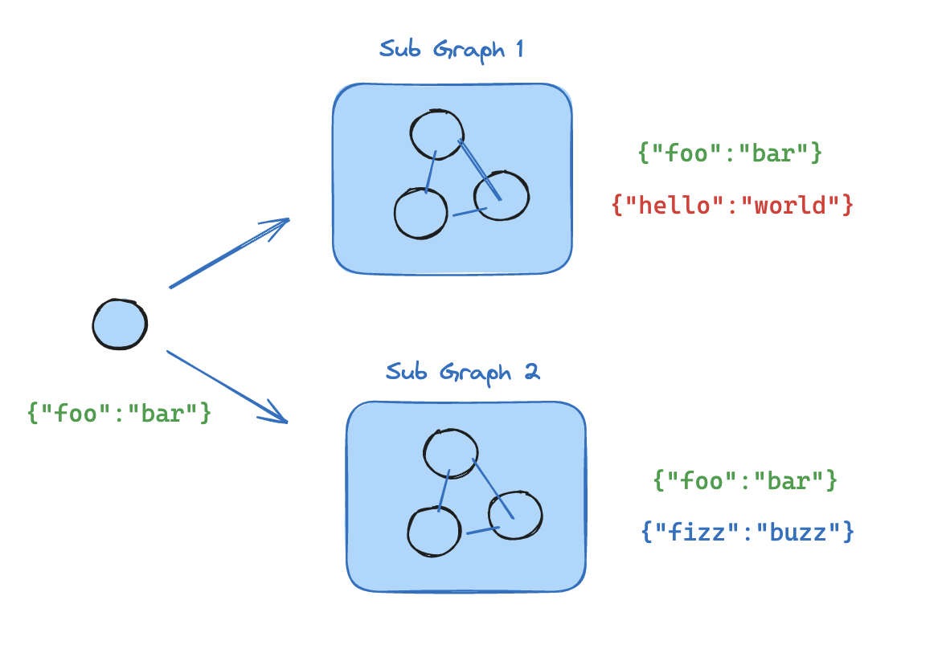
Add subgraph as node
When the parent graph and subgraph share state keys, you can pass a compiled subgraph directly to add_node.
The subgraph reads from and writes to the parent’s state channels automatically. For example, in multi-agent systems, the agents often communicate over a shared messages key.
Notes:
The simplest pattern — when state schemas are compatible:
builder.add_node('analysis', subgraph) # That's it!
LangGraph automatically:
- Routes shared state keys to the subgraph
- Keeps private subgraph keys (keys not in parent schema) invisible to parent
- Returns shared key updates back to parent state
Example: If both parent and subgraph have 'messages' and 'foo', but subgraph also has 'bar':
- Parent passes messages and foo to subgraph
- Subgraph can use bar internally
- Parent receives updated messages and foo back
- Parent never sees bar

Slide 28
Subgraph as node: example
sub_builder = StateGraph(State)
def node1(state):
...
def node2(state):
...
sub_builder.add_node("node1", node1)
sub_builder.add_node("node2", node2)
sub_builder.add_edge(START, "node1")
sub_builder.add_edge("node1", "node2")
subgraph = sub_builder.compile()
main_builder = StateGraph(State)
main_builder.add_node("analysis", subgraph)
main_builder.add_edge(START, "analysis")
main_graph = main_builder.compile()
Notes:
Walk through the code:
1. Build the subgraph with its own StateGraph, nodes, edges
2. Compile the subgraph: subgraph = sub_builder.compile()
3. Add compiled subgraph as a node: main_builder.add_node('analysis', subgraph)
4. Connect with edges: main_builder.add_edge(START, 'analysis')
The subgraph runs as a complete graph internally — its own nodes execute in order, its own conditional edges are evaluated. From the parent's perspective, it's just a single node that happens to have internal structure.
This is powerful for organizing complex workflows — each major capability can be its own subgraph with clear boundaries.

Slide 29
Subgraph persistence
When you use a subgraph, you need to decide what happens to its internal data between calls
Stateful subgraphs inherit the parent graph’s checkpointer, which enables interrupts, durable execution, and state inspection. The two stateful modes (per-invocation, per-thread) differ in how long state is retained.
Mode | checkpointer | Behavior
Per-invocation | None (default) | Each call starts fresh and inherits the parent’s checkpointer to support interrupts and durable execution within a single call.
Per-thread | True | State accumulates across calls on the same thread. Each call picks up where the last one left off.
Stateless | False | No checkpointing at all—runs like a plain function call. No interrupts or durable execution.
Notes:
Subgraph persistence is inherited from the parent graph's checkpointer. Three modes:
1. PER-INVOCATION (default, checkpointer=None):
- Each call starts fresh — no memory of previous calls
- Still supports interrupts and durable execution within a single call
- Best for stateless subagents: 'look up this order', 'summarize this document'
2. PER-THREAD (checkpointer=True):
- State accumulates across calls on the same thread
- Good for subagents that need context: research assistants, coding assistants
- Warning: Does NOT support parallel tool calls to the same subgraph
3. STATELESS (checkpointer=False):
- No checkpointing at all — runs like a plain function
- No interrupts, no durable execution
- Use when you want raw speed and don't need persistence

Slide 30
Checkpointer inheritance
Checkpointer inheritance gives the subgraph three important capabilities:
Interrupts – a subgraph can call interrupt() and pause execution, then resume later from saved state. This only works when checkpointing is present.
Durable execution – if execution stops or fails, LangGraph can resume from the last saved checkpoint instead of rerunning everything from scratch.
State inspection – you can inspect saved subgraph state using APIs such as get_state(..., subgraphs=True).
Notes:
Three capabilities enabled by checkpointer inheritance:
1. INTERRUPTS: A subgraph can call interrupt() and pause execution. The parent graph also pauses. When you resume the parent, the subgraph continues from where it stopped. This enables human-in-the-loop at any depth.
2. DURABLE EXECUTION: If the process crashes mid-run, LangGraph can resume from the last checkpoint. The subgraph doesn't need to re-run completed steps — their results are already saved.
3. STATE INSPECTION: Using get_state(config, subgraphs=True), you can inspect the internal state of subgraphs. This is invaluable for debugging multi-agent systems.
Important: The parent MUST be compiled with a checkpointer for any of these features to work in subgraphs.

Slide 31
Subgraph persistence
Per-invocation (default)
Used when each call to the subgraph is independent and the subagent doesn’t need to remember anything from previous calls.
Most common pattern, where subagents handle requests like “look up this customer’s order” or “summarize this document.”
Safer support for parallel calls, because each invocation gets its own checkpoint namespace and isolated state.
Per-thread (same thread id)
Used when a subagent needs to remember previous interactions.
For example, a research assistant that builds up context over several exchanges, or a coding assistant that tracks what files it has already edited.
The subagent’s conversation history and data accumulate across calls on the same thread. Each call picks up where the last one left off.
Notes:
Per-invocation vs Per-thread in practice:
PER-INVOCATION (most common):
config = {'configurable': {'thread_id': '1'}}
response1 = agent.invoke({'messages': [{'content': 'Tell me about apples'}]}, config)
# Subagent processes 4 messages
response2 = agent.invoke({'messages': [{'content': 'Tell me about bananas'}]}, config)
# Subagent starts FRESH — still 4 messages, not 8
PER-THREAD (accumulating):
# Same setup but subgraph compiled with checkpointer=True
response1 = agent.invoke(...) # 4 messages
response2 = agent.invoke(...) # 8 messages (remembers apples!)
Choose per-invocation unless you specifically need the subagent to remember previous interactions.

Slide 32
DEMO (Subgraphs)
Notes:
Demo: 11.subgraphs.ipynb
Walk through:
1. Pattern 1 — Build a subgraph with shared state (both use MessagesState)
2. Pattern 2 — Build a subgraph with different state (parent has 'foo', sub has 'bar')
3. Practical example — Supervisor with research and math subgraphs
4. Persistence — Show per-invocation behavior
Key takeaway: Subgraphs are the building blocks of production multi-agent systems. They provide modularity, isolation, and reusability.

Slide 33
Langgraph streaming
Delivering partial execution results in real time while the graph is still running
Every compiled graph exposes two methods:
graph.stream(...) → synchronous streaming
graph.astream(...) → asynchronous streaming
Both functions return an iterator of events that you read in a loop as the graph executes.
The output you receive depends on the stream mode(s) you pass in stream_mode. LangGraph supports several types, each designed for a different purpose.
Notes:
Streaming is critical for building responsive AI applications. Without streaming, users stare at a blank screen until the entire graph finishes executing — which could be seconds or minutes.
LangGraph provides first-class streaming support through two APIs:
1. graph.stream() / graph.astream() — Low-level, mode-based control
2. graph.stream_events() / graph.astream_events() — High-level, recommended for new apps
The key concept is STREAM MODES — different modes give you different types of events:
- 'values': Full state snapshot after each step
- 'updates': Only the changes (deltas) after each step
- 'messages': Token-by-token LLM output
- 'custom': Your own progress events from nodes
You can combine multiple modes in a single stream call.
Demo: 12.streaming.ipynb

Slide 34
Stream_mode="updates"
This mode emits state updates after each graph step. Each time a node executes and modifies the graph’s state, a new event appears.
Example sequence for a tool‑calling agent:
LLM creates tool call | Tool node returns the tool result | LLM creates final result
Each of these steps is streamed individually so progress becomes visible.
for chunk in graph.stream(inputs, stream_mode="updates", version="v2"):
print(chunk)
Notes:
stream_mode='updates' is the most commonly used mode. It emits a dict after each node executes, showing ONLY what that node changed.
Example output for a tool-calling agent:
Step 1: {'assistant': {'messages': [AIMessage(tool_calls=[...])]}}
Step 2: {'tools': {'messages': [ToolMessage(content='42')]}}
Step 3: {'assistant': {'messages': [AIMessage(content='The answer is 42')]}}
Each event shows which node produced it and what state it changed. This is perfect for showing progress in a UI.
With version='v2', the output format is standardized as StreamPart dicts:
{'type': 'updates', 'ns': (), 'data': {'node_name': {...}}}
The 'ns' (namespace) field shows subgraph nesting — empty tuple for root graph, populated for subgraph events.

Slide 35
Stream_mode=“messages"
This mode streams tokens generated by language models as they are produced.
Instead of waiting for a full LLM response, tokens arrive incrementally. Used for building responsive interfaces
Stream_mode=“Custom"
Nodes inside your graph can emit arbitrary user‑defined streaming events.
"Fetched 20/100 records"
"Analyzing documents..."
Notes:
stream_mode='messages' gives you token-level streaming from LLM calls. Instead of waiting for the full response, tokens arrive one by one as the LLM generates them.
for msg, metadata in graph.stream(inputs, stream_mode='messages'):
if isinstance(msg, AIMessageChunk):
print(msg.content, end='', flush=True)
This is essential for chat interfaces where users expect to see text appearing in real-time.
CUSTOM STREAMING: Nodes can also emit arbitrary events using get_stream_writer():
from langgraph.config import get_stream_writer
def my_node(state):
writer = get_stream_writer()
writer('Fetching data...')
# do work
writer('Processing complete')
return state
Use stream_mode='custom' to receive these events.

Slide 36
Other streaming modes
Used for inspection, debugging, or advanced monitoring of graph execution.
Values
Checkpoints
Tasks
debug
Notes:
Additional streaming modes for advanced use cases:
VALUES: Full state snapshot after each step (not just deltas). Useful when you need the complete state, not just changes.
CHECKPOINTS: Emits checkpoint events in the same format as get_state(). Useful for monitoring persistence.
TASKS: Task start/finish events with results and errors. Good for tracking execution progress.
DEBUG: Everything — combines checkpoints and tasks with extra metadata. Use for development and troubleshooting.
You can combine modes: stream_mode=['updates', 'messages'] gives you both state changes AND token streaming in the same stream.
With version='v2', all modes use the same StreamPart format, making it easy to filter: if chunk['type'] == 'messages': ...

Slide 37
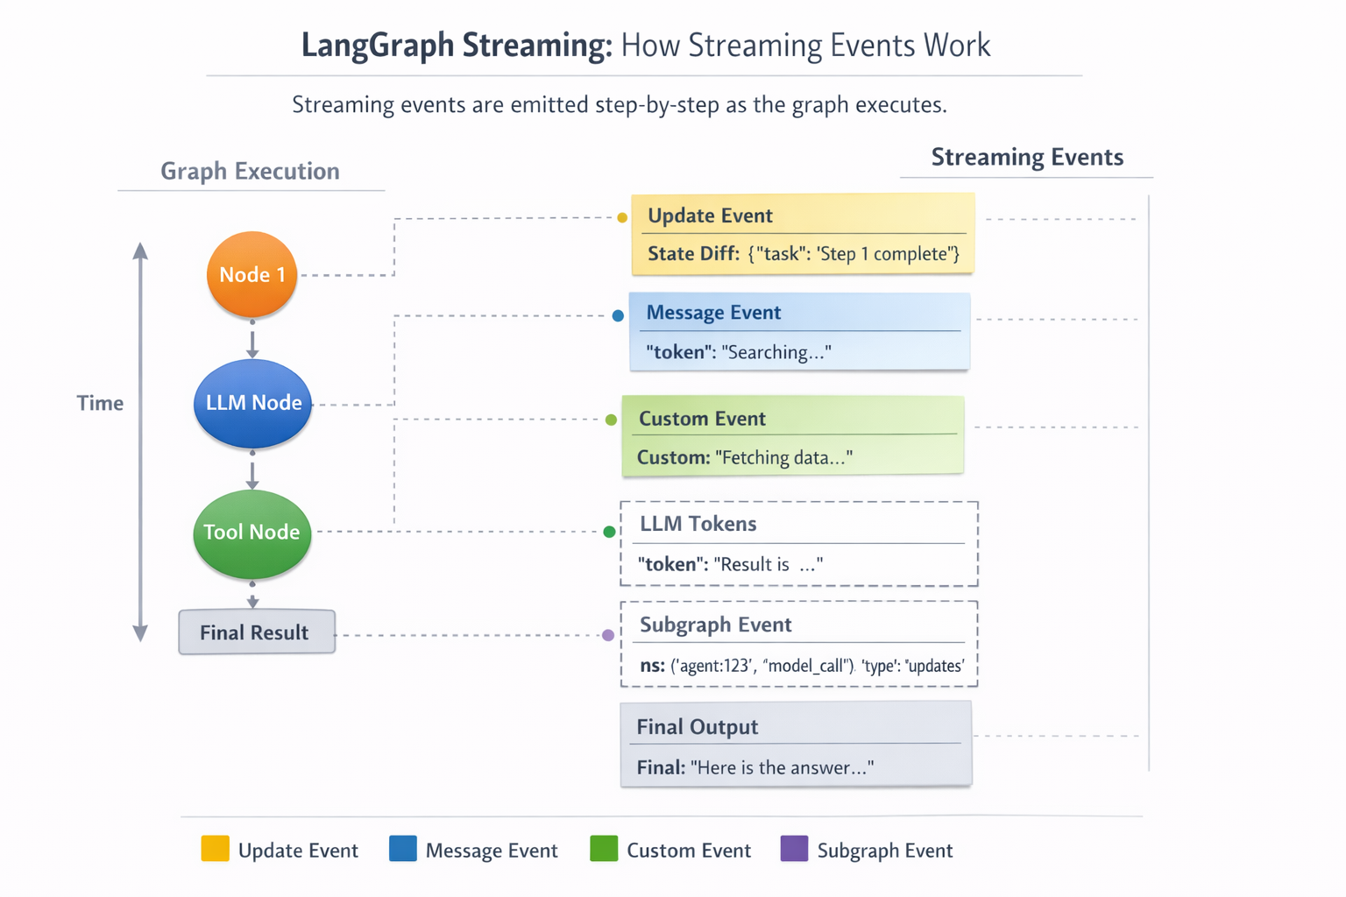
Notes:
Transition to the Persistence section. We've seen how to stream graph execution in real-time. Now let's look at how LangGraph saves and restores state — the foundation for memory, durability, and time-travel debugging.

Slide 38
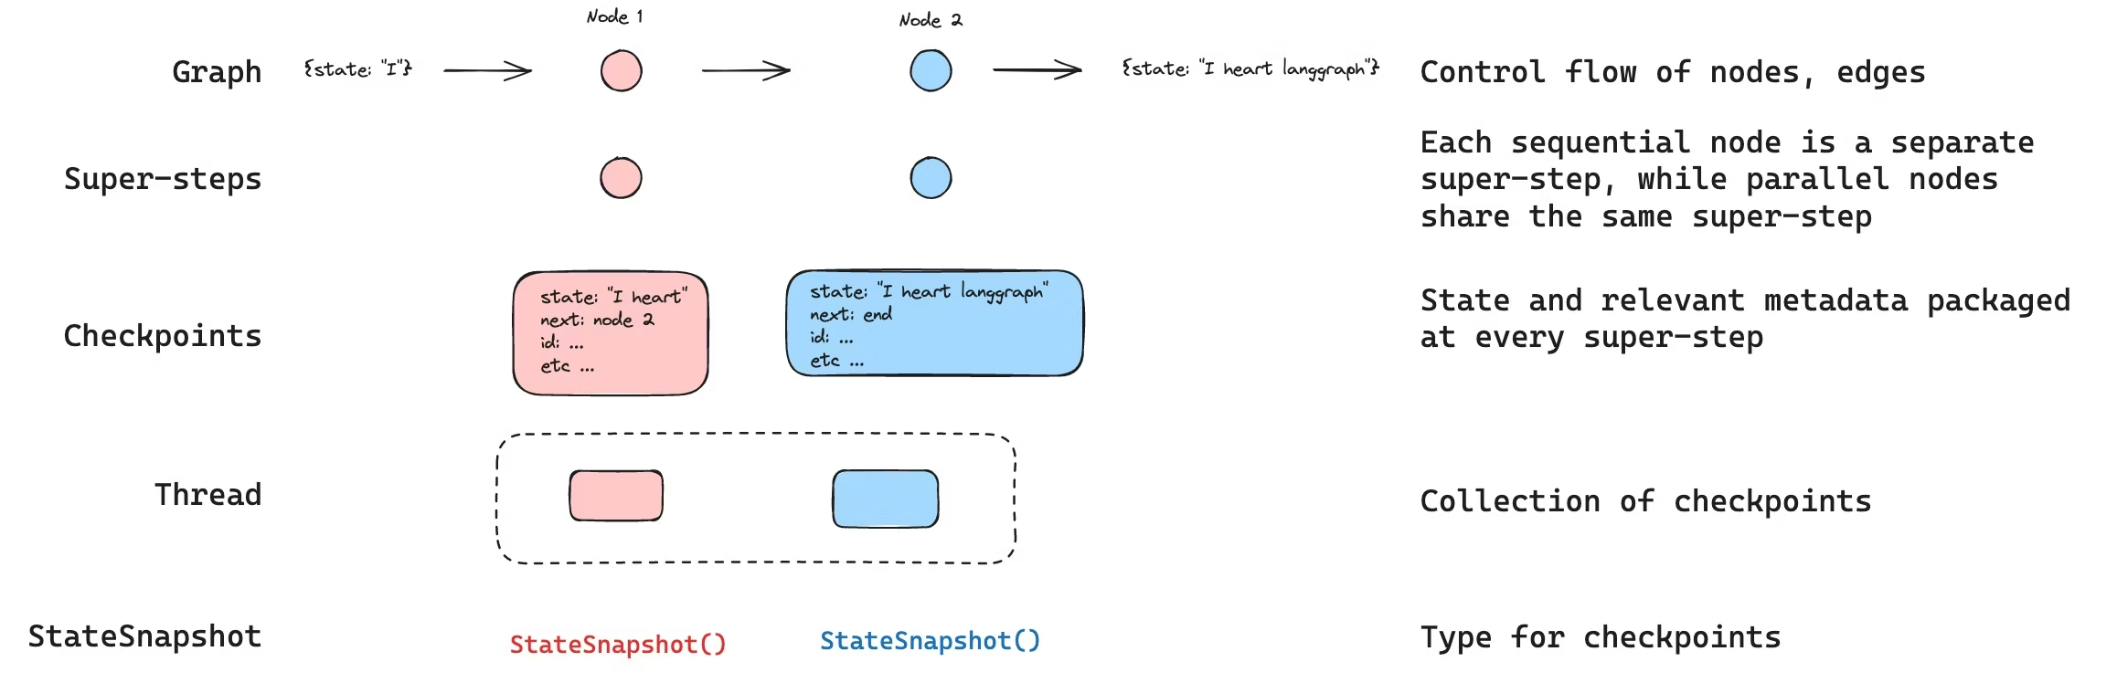
Langraph - Persistence
LangGraph has a built-in persistence layer that saves graph state as checkpoints.
When you compile a graph with a checkpointer, a snapshot of the graph state is saved at every step of execution, organized into threads.
Notes:
LangGraph's persistence layer has two complementary systems:
1. CHECKPOINTERS (short-term, thread-scoped):
- Save graph state snapshots at every super-step
- Organized by thread_id — each conversation is a thread
- Enable: memory, fault-tolerance, HITL, time-travel
2. STORES (long-term, cross-thread):
- Persistent key-value store that survives across threads
- For user profiles, preferences, learned patterns
- Namespace-based organization for multi-tenant isolation
A checkpoint is created at each 'super-step' — one tick of the graph where all scheduled nodes for that step run. For a simple graph START→A→B→END, there are 4 checkpoints.
Demo: 13.persistence_and_tasks.ipynb

Slide 39
Langgraph - durability
Durable execution is a technique in which a process or workflow saves its progress at key points, allowing it to pause and later resume exactly where it left off.
Enable persistence in your workflow by specifying a checkpointer that will save workflow progress.
Specify a thread identifier when executing a workflow. This will track the execution history for a particular instance of the workflow.
Wrap any non-deterministic operations (e.g., random number generation) or operations with side effects (e.g., file writes, API calls) inside tasks to ensure that when a workflow is resumed, these operations are not repeated
Notes:
Durable execution is what makes LangGraph production-ready. If a process crashes mid-run, it can resume from the last saved checkpoint instead of starting over.
Three requirements for durable execution:
1. A checkpointer (saves progress)
2. A thread_id (identifies the execution instance)
3. Tasks wrapping non-deterministic work (prevents replay issues)
Without durability, a crash during a 10-step agent workflow means re-running ALL steps. With durability, we resume from step 8 (or wherever we crashed).
This is especially important for:
- Long-running research agents
- Multi-step data processing pipelines
- Workflows with expensive API calls
- Any agent that interacts with external systems

Slide 40
Anything expensive, side-effecting, or non-deterministic should be isolated in tasks.
Notes:
Three durability modes control WHEN checkpoints are persisted:
EXIT MODE (default):
- Checkpoint saved only when graph exits (success, error, or interrupt)
- Fastest — no I/O during execution
- Risk: If process crashes mid-run, intermediate progress is lost
- Use for: Simple agents, development, low-risk workflows
ASYNC MODE:
- Checkpoint saved asynchronously while next step starts
- Good balance of speed and durability
- Small risk: If crash happens at exactly the wrong moment, latest checkpoint may not be written
- Use for: Most production applications
SYNC MODE:
- Checkpoint saved synchronously BEFORE next step starts
- Strongest guarantee — no data loss possible
- Slowest — adds I/O latency between every step
- Use for: Critical workflows where losing ANY step is unacceptable
Set with: graph.invoke(input, config, checkpoint_during='async')

Slide 41
Durability modes in LangGraph
exit
State is persisted only when graph execution exits successfully, with an error, or via interrupt.
Fastest, but if the process crashes mid-run, intermediate progress is not saved.
async
State is persisted asynchronously while the next step runs.
Good balance of speed and durability
Small risk that the latest checkpoint is not written if the process crashes at the wrong moment.
sync
State is persisted synchronously before the next step starts.
Strongest durability
Highest overhead / slowest of the three.
Notes:
The @task decorator is critical for correct durable execution. Without it, replayed nodes will re-execute ALL their code — including API calls, file writes, and random operations.
Example problem:
def my_node(state):
result = requests.get('https://api.example.com/data') # Side effect!
random_id = uuid.uuid4() # Non-deterministic!
return {'data': result.text, 'id': random_id}
If this node is replayed from a checkpoint, it makes ANOTHER API call and generates a DIFFERENT random ID. This is incorrect.
Solution — wrap in @task:
@task
def fetch_data(url):
return requests.get(url).text
The @task decorator caches the result. On replay, the cached result is returned without re-executing the code.

Slide 42
Use exit for simpler or lower-risk runs.
Use async for many real-world apps.
Use sync when you really care about not losing the latest step
Notes:
Practical guidance for choosing durability modes:
EXIT: Use during development and testing. The fastest option, and you probably don't care about crash recovery in a notebook.
ASYNC: Use for most production deployments. The tiny risk of losing the latest checkpoint is acceptable for 99% of use cases. The performance benefit over sync mode is significant.
SYNC: Use when compliance or business rules require zero data loss. Examples: financial transactions, medical record processing, audit-trail-required workflows.
Remember: Durability only matters for the LATEST step. All previously completed steps are already persisted regardless of mode.

Slide 43
Tasks
A task in LangGraph is the unit you should use to wrap:
side effects (API calls, file writes, database writes, tool invocations)
non-deterministic operations (randomness, variable external responses)
and any work you do not want repeated on resume/replay
LangGraph does not literally resume from the exact source-code line where it crashed. Instead, it restarts from an appropriate checkpoint boundary and may replay part of the workflow to reach the stopping point.
Notes:
Rule of thumb: If code inside a node does ANYTHING other than pure computation, wrap it in @task.
Needs @task:
- API calls (requests.get, OpenAI calls)
- Database writes
- File system operations
- Random number generation
- Current time/date
Does NOT need @task:
- String formatting
- Math calculations
- Dictionary manipulation
- Anything that produces the same output for the same input
LangGraph does NOT resume from the exact line where it crashed. It restarts from the last checkpoint boundary and REPLAYS the node. Tasks prevent the replayed code from having side effects.

Slide 44
tasks
def call_api(state: State):
"""Example node that makes an API request."""
result = requests.get(state['url']).text[:100]
return { "result": result }
@task def _make_request(url: str):
"""Make a request."""
return requests.get(url).text[:100]
Notes:
Compare the two versions:
WITHOUT @task:
def call_api(state):
result = requests.get(state['url']).text[:100]
return {'result': result}
# Problem: Replayed → makes another HTTP request
WITH @task:
@task
def _make_request(url):
return requests.get(url).text[:100]
def call_api(state):
result = _make_request(state['url'])
return {'result': result}
# Correct: Replayed → returns cached result
The @task function:
1. First run: Executes normally, caches result in checkpoint
2. Replay: Returns cached result without executing
3. Different inputs: Executes again (cache is per-input)
Note: @task is from the Functional API (langgraph.func.task). It works inside StateGraph nodes.

Slide 45
Deployment
Notes:
Transition slide to the Deployment section. We've covered all the building blocks: graphs, state, reducers, tools, agents, memory, subgraphs, streaming, and persistence. Now let's look at how to take these graphs to production.

Slide 46
LangSmith Deployment
LangSmith Deployment is a workflow orchestration runtime purpose-built for agent workloads.
It take your agent code (for example a LangGraph graph) and expose it as a production‑ready API service with built‑in state management, scaling, monitoring, and persistence.
LangSmith Deployment is framework-agnostic: you can deploy agents built with LangGraph or other frameworks.
Notes:
LangSmith Deployment (also called LangGraph Platform) is the production runtime for LangGraph agents.
Key value proposition: You write graph code, and LangSmith handles:
- State management (PostgreSQL-backed persistence)
- Scaling (horizontal scaling of agent workloads)
- Monitoring (traces, metrics, debugging)
- API endpoints (REST API for your agents)
- Persistence layer (checkpointing, stores)
It's framework-agnostic — you can deploy LangGraph graphs OR other agent frameworks. The deployment layer doesn't care about your graph internals.
Three deployment options:
1. Cloud (hosted by LangChain): Fastest to set up
2. Self-hosted: Deploy on your own infrastructure
3. Hybrid: LangChain manages orchestration, you manage compute

Slide 47
Langsmith deployment (cont…)
LangSmith’s deployment layer provides:
Durable execution of agent workloads with persistent state & conversation memory
API endpoints for interacting with agents
Monitoring and debugging tools
Deployment infrastructure (cloud, hybrid, or self‑hosted)
Notes:
The deployment layer provides five key capabilities:
1. DURABLE EXECUTION: Checkpointing with PostgreSQL-backed persistence. Agents can run for hours and survive crashes.
2. API ENDPOINTS: Every deployed graph gets REST endpoints for invoke, stream, create threads, manage assistants.
3. MONITORING: Built-in integration with LangSmith tracing. Every step of every agent run is logged and searchable.
4. DEPLOYMENT INFRASTRUCTURE: Docker-based deployment with auto-scaling, health checks, and rollback support.
5. MEMORY: Both short-term (thread checkpoints) and long-term (Store) memory are managed by the platform.

Slide 48
Agent Server
When you deploy to LangSmith, you are basically deploying to an Agent Server — a backend service designed to execute agent graphs.
Agent server exposes a structured API for managing agents and their executions.
Agent Server API is built around four main concepts:
Entity | What it represents
Assistant | a configured agent
Thread | an execution context with shared state
Run | one execution of the agent
Store | persistent key‑value memory
Notes:
The Agent Server is what actually runs your graphs. When you deploy to LangSmith, you're deploying to an Agent Server instance.
The API is built around four core concepts — we'll cover each in the next slides:
1. Assistants: Configured instances of your graphs
2. Threads: Conversation sessions with persistent state
3. Runs: Individual invocations of a graph
4. Store: Long-term memory layer

Slide 49
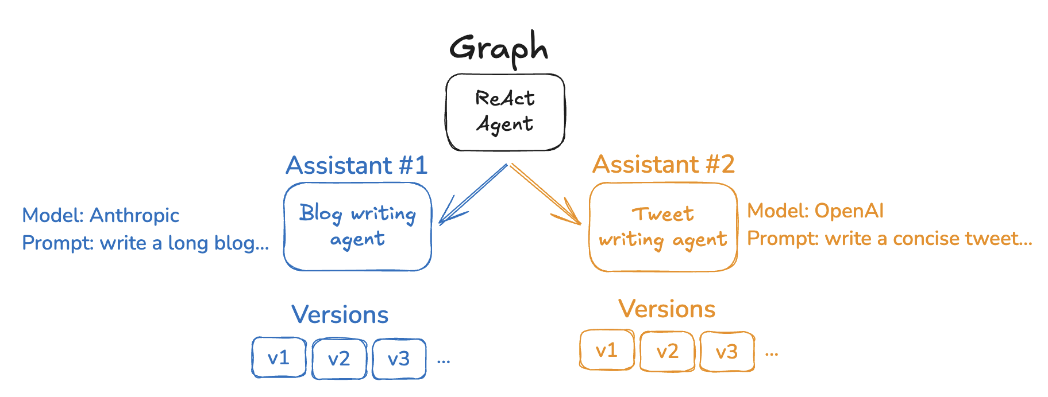
Agent Server: Assistant
Assistants are an Agent Server concept that allow you to manage configurations (e.g., prompts, LLM selection, tools) separately from your graph’s core logic.
This enables you to create multiple, specialized versions of the same graph architecture with different behavior at runtime.
Notes:
Assistants decouple configuration from code. Your graph defines the STRUCTURE (nodes, edges, logic), and assistants define the BEHAVIOR (which model to use, what prompt, which tools).
This means one graph can power multiple assistants:
- 'Blog Writer' assistant: Uses GPT-4, creative writing prompt, web search tool
- 'Technical Writer' assistant: Uses GPT-4, technical prompt, documentation search tool
- 'Summarizer' assistant: Uses GPT-3.5 (cheaper), summarization prompt, no tools
All three use the same graph architecture but produce very different behavior.

Slide 50
Assistant
An assistant is just an instance of a graph with a specific configuration.
Multiple assistants can reference the same graph but can contain different configurations (e.g. prompts, models, tools).
assistant = await client.assistants.create(
“writing_agent",
context={"model_name": "openai"},
name=“Blog Writer"
)
result = await client.runs.wait(
thread["thread_id"],
assistant["assistant_id"],
input={
"messages": [ ... ]
},
)
Notes:
Creating and using an assistant via the SDK:
# Create an assistant with specific configuration
assistant = await client.assistants.create(
'writing_agent', # graph name from langgraph.json
context={'model_name': 'openai'},
name='Blog Writer'
)
# Use the assistant to process a request
result = await client.runs.wait(
thread['thread_id'],
assistant['assistant_id'],
input={'messages': [...]},
)
The assistant_id is what you pass to runs — it tells the server WHICH configuration to use when running the graph.

Slide 51
Langgraph store
Store is the long-term memory layer: a persistent key-{value|document} store that survives across threads and conversations, unlike thread state/checkpoints which are scoped to runs or threads.
Agent Server stores long-term memory in PostgreSQL by default and can use a custom store implementation instead.
When you deploy on Agent Server, the server injects the configured store into graph execution. Completely decoupled from the code.
Do not configure the store in your graph code for Agent Server, because the server manages it for runtime operations.
Notes:
The Store is LangGraph's long-term memory layer. While checkpointers handle thread-scoped state (conversation history), the Store handles cross-thread data.
Key design decisions:
1. Namespace-based: Data is organized under hierarchical namespaces like ('users', 'user123')
2. Key-value: Each item has a key and a JSON value document
3. Searchable: You can filter by field values and use semantic ranking
4. Multi-tenant: Include tenant ID in namespace for data isolation
The Store is automatically managed by the Agent Server — you don't configure it in your graph code. This decouples persistence from application logic.

Slide 52
Langgraph store
# Read it back
item = await client.store.get_item(namespace, key)
print("GET:", item)
# Search under a namespace prefix
results = await client.store.search_items(
["users"],
filter={"preferences.language": "en"},
query="concise tone"
)
print("SEARCH:", results)
# List namespaces
namespaces = await client.store.list_namespaces()
print("NAMESPACES:", namespaces)
# Writing to store
namespace = ["users", "user123"]
key = "profile“
# Put / upsert a document
await client.store.put_item(
namespace,
key,
{
"name": “Ahmed",
"preferences": {
"tone": "concise",
"language": "en"
}
}
)
Notes:
Store API examples:
WRITE:
await client.store.put_item(['users', 'user123'], 'profile', {'name': 'Ahmed', 'preferences': {'tone': 'concise'}})
READ:
item = await client.store.get_item(['users', 'user123'], 'profile')
SEARCH:
results = await client.store.search_items(['users'], filter={'preferences.language': 'en'})
LIST NAMESPACES:
namespaces = await client.store.list_namespaces()
Best practice: Use tenant-specific namespaces like ('tenant_a', 'customers', 'c42') to prevent data leakage in multi-tenant applications.

Slide 53
Langgraph store
Long-term memory is stored as JSON documents under a namespace + key model, and search can work within namespace prefixes with filters and semantic ranking.
A very good pattern is to include tenant ID in the namespace, so memories don’t leak across users.
("tenant_a", "customers", "c42")
This gives you:
data isolation
cleaner search boundaries
easier multi-tenant enforcement.
Notes:
Multi-tenancy with the Store:
Namespace pattern: (tenant_id, resource_type, resource_id)
Example: ('tenant_a', 'customers', 'c42')
This gives you:
1. DATA ISOLATION: search_items(['tenant_a']) only returns tenant_a's data
2. CLEAN BOUNDARIES: No accidental cross-tenant queries
3. EASY ENFORCEMENT: Middleware can validate tenant_id before any Store operation
The Store uses PostgreSQL by default but supports custom implementations. In production, you'd typically add encryption at rest and audit logging on top of the basic Store.

Slide 54
Langgraph.JSON
langgraph.json is the configuration file that defines how a LangGraph application should be built and run by the LangGraph CLI / Agent Server. In practice, it tells the runtime:
which graphs exist
how to load them
what dependencies to install
how to configure the server and runtime
At runtime, LangGraph starts an Agent Server that runs graphs, which exposes API endpoints for runs, threads, assistants, etc. based on langgraph.json
Notes:
langgraph.json is the entry point for LangGraph CLI and Agent Server. It defines:
1. GRAPHS: Which Python modules contain your graph definitions, and what variable names to look for
2. DEPENDENCIES: What packages to install in the server environment
3. ENV: Path to your .env file for secrets
Think of it like a Dockerfile + docker-compose.yml for your agent application. It tells the runtime everything it needs to build and start your agent server.
At runtime, the LangGraph CLI reads this file, installs dependencies, imports your graphs, and starts an Agent Server that exposes REST API endpoints for runs, threads, assistants, and store operations.

Slide 55
Langgraph.jSON
{
"dependencies": ["./", "langchain_openai"],
"graphs": {
"research": "./my_agent/research.py:graph",
"sql": "./my_agent/sql.py:graph",
"writer": "./my_agent/writer.py:graph",
"supervisor": "./my_agent/supervisor.py:graph"
},
"env": "./.env"
}
Notes:
Example langgraph.json with multiple graphs:
{
'dependencies': ['./', 'langchain_openai'],
'graphs': {
'research': './my_agent/research.py:graph',
'sql': './my_agent/sql.py:graph',
'writer': './my_agent/writer.py:graph',
'supervisor': './my_agent/supervisor.py:graph'
},
'env': './.env'
}
Each graph entry maps a name to a Python module:variable path. The CLI imports the module and accesses the variable to get the compiled graph.
This multi-graph setup is common in production — you deploy several related agents in one server, each accessible by its graph name.

Slide 56
Dependencies
dependencies tells the LangGraph CLI / Agent Server what packages or local code it needs to install so your graph can import and run successfully
When you run commands like langgraph dev, langgraph build, or langgraph up, the CLI reads langgraph.json and uses dependencies to prepare the runtime environment for your graph server.
Basically, it determines what Python packages and local project code should be installed inside the server environment before your graph is loaded.
Notes:
Dependencies in langgraph.json tell the CLI what to install:
'./' or '.' — Install the current project as a package. Looks for pyproject.toml, setup.py, or requirements.txt in the specified directory.
'./my_package' — Install a local subdirectory as a package.
'langchain_openai' — Install from PyPI (or whatever package index is configured).
Important: Point to DIRECTORIES, not files. The CLI will find the right setup file automatically.
The CLI runs dependency installation when you do:
- langgraph dev (development server)
- langgraph build (Docker image)
- langgraph up (start server)

Slide 57
dependencies
A single period "." This tells the CLI to look for and install the current local Python package/project.
A local directory path such as "./" or "./my_package" This points to the directory that contains your pyproject.toml, setup.py, or requirements.txt. The docs explicitly say you should point to the directory, not the file itself.
A Python package name such as "langchain_openai" This installs a package from the Python environment/package index so your graph can import it.
Notes:
The LangGraph CLI provides several commands for development and deployment:
langgraph dev: Start a local development server at http://127.0.0.1:2024
- In-memory persistence (data lost on restart)
- Hot-reload on code changes
- Opens LangSmith Studio UI for testing
langgraph build: Build a Docker image of your agent server
- Packages your code and dependencies
- Ready for deployment to any Docker host
langgraph up: Start a production-ready server
- Uses Docker Compose under the hood
- PostgreSQL for persistent storage
- Ready for production traffic

Slide 58
Langraph CLI
Command | What it does
langgraph dev | Starts a lightweight local dev server, ideal for rapid testing.
langgraph build | Builds a Docker image of your LangGraph API server for deployment.
langgraph deploy | Builds and deploys a LangGraph image directly to LangSmith Deployments in a single step.
langgraph dockerfile | Emits a Dockerfile derived from your config for custom builds.
langgraph up | Starts the LangGraph API server locally in Docker. Requires Docker running; LangSmith API key for local dev; license for production.
Notes:
The LangGraph CLI uses the langgraph.json to configure the server. Important: Use langgraph dev for development and testing only. For production, use LangSmith Deployment which provides:
- Managed PostgreSQL for checkpointing and Store
- Auto-scaling based on agent workload
- Monitoring and alerting integration
- Rolling deployments with zero downtime

Slide 59
Langsmith Local Development Server
c:\>langgraph dev
INFO:langgraph_api.cli:
Welcome to
╦ ┌─┐┌┐┌┌─┐╔═╗┬─┐┌─┐┌─┐┬ ┬
║ ├─┤││││ ┬║ ╦├┬┘├─┤├─┘├─┤
╩═╝┴ ┴┘└┘└─┘╚═╝┴└─┴ ┴┴ ┴ ┴
- 🚀 API: http://127.0.0.1:2024
- 🎨 Studio UI: https://smith.langchain.com/studio/?baseUrl=http://127.0.0.1:2024
- 📚 API Docs: http://127.0.0.1:2024/docs
This in-memory server is designed for development and testing.
For production use, please use LangSmith Deployment.
Notes:
The local development server gives you:
1. API at http://127.0.0.1:2024 — REST endpoints for all operations
2. Studio UI via LangSmith — Visual interface for testing your agents
3. API Docs at /docs — OpenAPI documentation for all endpoints
Key features for development:
- Test your agents interactively through the Studio UI
- Inspect thread state and checkpoint history
- Test streaming behavior
- Debug agent decision-making
Remember: This is an IN-MEMORY server. Data is lost on restart. For persistent development, use langgraph up with Docker.
Demo: 11b.deployment.ipynb

Slide 60
Human-in-the-Loop
Gating agent actions with human approval
Notes:
This section covers one of the most important patterns for production agents: human-in-the-loop (HITL).
In production, agents often need human approval before executing critical actions like sending emails, making purchases, or modifying databases. LangGraph provides two mechanisms for HITL:
1. Static interrupts: interrupt_before / interrupt_after (compile-time flags, now recommended mainly for debugging)
2. Dynamic interrupts: The interrupt() function placed inside node code (recommended for production HITL)
The newer Command primitive is the canonical way to resume from any interrupt.
Demo: 8.human_in_the_loop.ipynb

Slide 61
Why Human-in-the-Loop?
Production agents need guardrails for high-stakes actions
Examples of actions requiring human approval:
Sending emails or messages
Making purchases or financial transactions
Modifying production databases
Deploying code changes
LangGraph provides two interrupt mechanisms:
interrupt_before / interrupt_after (static, compile-time)
interrupt() function (dynamic, inside node code)
Both require a checkpointer to save state at the pause point
Notes:
Human-in-the-loop is essential when an agent's actions have real-world consequences. The key insight is that we want the agent to PLAN the action, then PAUSE for human review, then either EXECUTE or ABORT based on the human's decision.
From the official docs: 'Static interrupts are not recommended for human-in-the-loop workflows. Use the interrupt() function instead.' However, interrupt_before/after are still valuable for debugging — they let you add breakpoints to any node without modifying code.
Both mechanisms require a checkpointer because the graph state must be saved when execution pauses. Without persistence, there's nowhere to store the pending state while waiting for human input.
The interrupt_before/after approach is simpler to understand initially, which is why we teach it first in the notebook.

Slide 62
interrupt_before: Gate Tool Execution
Pause the graph BEFORE a specific node executes
graph = builder.compile(
checkpointer=MemorySaver(),
interrupt_before=['tools'] # Pause before tools run
)
When the LLM decides to call a tool, execution stops
Use get_state(config) to inspect what's pending
Resume with graph.invoke(None, config) # Approve
Or update_state() to reject/modify the action
Notes:
The interrupt_before mechanism works at the node boundary level. When you specify interrupt_before=['tools'], the graph will execute normally until it's about to enter the 'tools' node, then STOP.
At this point:
1. The state is checkpointed (including the LLM's tool call decision)
2. get_state(config).next shows which node would run next: ('tools',)
3. The last message in state contains the AIMessage with tool_calls
To approve: graph.invoke(None, config) — passing None means 'continue from where you stopped'
To reject: graph.update_state(config, {'messages': [ToolMessage(content='Denied', tool_call_id=...)]}, as_node='tools') — inject a denial response as if the tools node produced it, then resume.
You can also use interrupt_before='*' to pause before EVERY node — useful for step-by-step debugging.
The newer approach uses the interrupt() function inside node code for more granular control — you can pause at any point within a node, not just at boundaries.

Slide 63
Approve and Reject Patterns
APPROVE: Resume execution from pause point
result = graph.invoke(None, config)
REJECT: Update state to override the action
graph.update_state(
config,
{'messages': [ToolMessage(
content='Action denied by reviewer',
tool_call_id=tool_call_id
)]},
as_node='tools' # Act as the tools node
)
result = graph.invoke(None, config) # Resume
Notes:
The approve/reject pattern is elegant because it uses the same state management primitives we've already learned:
APPROVE is simple — invoke(None, config) tells LangGraph to continue executing from where it paused. The checkpointer loads the saved state and resumes at the next node.
REJECT is more nuanced. We use update_state() to inject a ToolMessage that says the action was denied. The key parameter is as_node='tools' — this tells LangGraph to apply this update AS IF it came from the tools node. This means the agent's next step (the assistant node) will see the denial message and respond accordingly, typically informing the user that the action was not performed.
The as_node parameter is important: it determines the graph's position after the update. By setting it to 'tools', we're saying 'the tools node already ran and produced this result', so the next step is whatever comes after the tools node (usually back to the assistant).
Alternative rejection approaches:
1. Modify the AIMessage to remove tool_calls, then resume
2. Use the Command primitive with Command(resume=value) for the interrupt() function
3. Simply don't resume — the conversation is abandoned at that point

Slide 64
Human-in-the-Loop
DEMO (Human-in-the-Loop)
Notes:
Demo: 8.human_in_the_loop.ipynb
Walk through:
1. Build an agent with send_email and search_contacts tools
2. Compile with interrupt_before=['tools']
3. Ask the agent to send an email — it pauses before execution
4. Inspect pending state with get_state()
5. Approve by invoking with None
6. New conversation: ask to send a problematic email
7. Reject by injecting a denial ToolMessage
8. Show how the agent gracefully handles the rejection
Key teaching points:
- The agent doesn't know it was interrupted — it just sees tool results
- Rejection looks like a normal tool response from the agent's perspective
- This pattern generalizes to any action that needs human approval

Slide 65
Multi-Agent Systems
Coordinating multiple specialized agents
Notes:
Multi-agent systems are where LangGraph truly shines. Instead of one monolithic agent with dozens of tools, we can build systems with specialized agents that each do one thing well.
From the official docs: 'Multi-agent patterns are particularly valuable when a single agent has too many tools and makes poor decisions about which to use, when tasks require specialized knowledge with extensive context, or when you need to enforce sequential constraints.'
The official LangGraph documentation recognizes five patterns:
1. Subagents (supervisor coordinates tools-as-agents)
2. Handoffs (agents transfer control via Command primitive)
3. Skills (specialized prompts loaded on-demand)
4. Router (classify input, route to specialist)
5. Custom Workflow (bespoke LangGraph graph)
We'll focus on the Supervisor and Sequential Handoff patterns.
Demo: 9.multi_agent.ipynb

Slide 66
Multi-Agent Architecture Patterns
Five official patterns (from LangGraph docs):
Subagents: Supervisor coordinates specialist agents as tools
Handoffs: Agents transfer control via Command primitive
Skills: Specialized prompts loaded on-demand
Router: Classify input, route to specialist
Custom Workflow: Bespoke LangGraph graph
When to use multi-agent over single agent:
Too many tools → poor tool selection
Domain-specific knowledge requiring long prompts
Sequential constraints (unlock capabilities after conditions)
Notes:
The five patterns represent different trade-offs:
SUBAGENTS (Supervisor): Best for distributed development and parallelization. Each subagent is a self-contained graph. The supervisor routes tasks and collects results. Downside: subagents can't directly interact with users.
HANDOFFS (Swarm-style): Best for conversational systems where agents need to talk to users directly. An agent calls a transfer_to_X tool to hand off control. Uses Command(goto='next_agent', graph=Command.PARENT) to escape the current subgraph.
SKILLS: Best when the task domain is known but requires specialized knowledge. A single agent loads different 'skill packs' (prompts + tools) based on the task. Simplest to implement.
ROUTER: Best for parallel processing. Classify the input, fan out to multiple specialists, merge results. Good for one-shot tasks (no multi-hop reasoning needed).
CUSTOM WORKFLOW: When none of the patterns fit. Mix deterministic logic with agentic behavior. Most production systems end up here.
The selection matrix from docs rates each pattern on: Distributed Development, Parallelization, Multi-hop reasoning, and Direct User Interaction.

Slide 67
Supervisor Pattern
A coordinator agent routes tasks to specialists
User → Supervisor → Research Agent
→ Math Agent
→ Writing Agent
Supervisor: Uses LLM to classify and route
Specialist: Has own tools and system prompt
Shared state: Agents communicate via MessagesState
Routing: Conditional edges based on supervisor decision
Notes:
The Supervisor pattern implementation:
1. Define a MultiAgentState extending MessagesState with a 'next_agent' field
2. Supervisor node: Invokes LLM with a routing prompt, returns which specialist to call
3. Specialist nodes: Each has own system prompt, tools, and capabilities
4. Routing function: Reads state['next_agent'] and returns the node name
5. Edges: Specialist → END (or → Supervisor for multi-hop)
Key implementation decisions:
- Supervisor prompt should return ONLY the routing decision, not engage with the task
- Specialists should be self-contained — handle tool execution internally
- For multi-hop (specialist needs more info), route specialist → supervisor → specialist
The Command primitive can simplify this: a tool call can include Command(goto='next_agent') to handle routing without explicit conditional edges.

Slide 68
Sequential Handoff Pattern
Agents collaborate in a pipeline
Researcher → Writer → Editor → END
Each agent adds to shared state:
Researcher: Fills 'research_notes' field
Writer: Uses notes, fills 'draft' field
Editor: Uses draft, fills 'final_output' field
Key: Use typed state fields for inter-agent communication
NOT just messages — structured fields are clearer
Notes:
The Sequential Handoff pattern is simpler than the Supervisor pattern but powerful for pipeline workflows where the order of operations is known.
Implementation:
1. Define a CollaborativeState with specific fields for each agent's output
2. Each agent reads from previous agents' fields and writes to its own
3. Fixed edges connect agents in sequence: researcher → writer → editor → END
Advantages over passing everything through messages:
- Type safety: Each field has a clear type and purpose
- Debugging: Easy to inspect intermediate results
- Modularity: Replace one agent without affecting others
Example state:
class CollaborativeState(MessagesState):
research_notes: str # Researcher writes this
draft: str # Writer writes this
final_output: str # Editor writes this
This pattern is great for content creation, data analysis pipelines, and review workflows.

Slide 69
Multi-Agent Systems
DEMO (Multi-Agent Systems)
Notes:
Demo: 9.multi_agent.ipynb
Walk through:
1. Supervisor pattern: Build supervisor + math_agent + research_agent
2. Test math routing: 'What is 15 * 23 + 47?'
3. Test research routing: 'Tell me about Python'
4. Sequential handoff: Build researcher → writer pipeline
5. Test with: 'Machine learning'
Key teaching points:
- Each specialist has its own tools and system prompt
- The supervisor is a simple classifier, not a complex agent
- State fields enable clean inter-agent communication
- The graph structure makes the architecture explicit and debuggable

Slide 70
Plan-and-Execute
Separating planning from execution
Notes:
Plan-and-Execute is an advanced agent architecture that addresses key limitations of the ReAct pattern.
From the official LangChain blog: 'It consists of two basic components: (1) A planner, which prompts an LLM to generate a multi-step plan to complete a large task. (2) Executor(s), which accept the user query and a step in the plan and invoke tools to complete that task.'
The academic foundation comes from the 'Plan-and-Solve Prompting' paper (Wang et al., 2023) and the Baby-AGI project by Yohei Nakajima.
Key advantages over ReAct:
1. Explicit long-term planning (which even strong LLMs struggle with in ReAct)
2. Ability to use smaller models for execution, larger models only for planning
3. Better trajectory quality by forcing full upfront reasoning
Demo: 10.plan_and_execute.ipynb

Slide 71
ReAct vs Plan-and-Execute
ReAct: Think one step at a time
Thought → Act → Observe → repeat
Each step requires full LLM reasoning
May produce sub-optimal trajectories
Plan-and-Execute: Plan first, then execute
Planner generates full multi-step plan upfront
Executor carries out each step (can use smaller model)
Replanner adjusts remaining steps after each execution
Benefits: Faster, cheaper, better trajectory quality
Notes:
From the official LangChain blog on planning agents:
ReAct limitations:
- 'Requires an LLM call for each tool invocation' — expensive and slow
- 'The LLM only plans for 1 sub-problem at a time — may lead to sub-optimal trajectories because it isn't forced to reason about the whole task'
Plan-and-Execute advantages (from the official JS notebook):
1. 'Explicit long term planning (which even really strong LLMs can struggle with)'
2. 'Ability to use smaller/weaker models for the execution step, only using larger/better models for the planning step'
Performance benefits:
- FASTER: The larger planning LLM doesn't need to be consulted after each action
- CHEAPER: Sub-tasks use smaller/domain-specific models; larger model only for (re-)planning
- BETTER: Forces the planner to explicitly think through ALL steps required upfront
The official Python tutorial uses gpt-4o for planning/replanning and a smaller model for execution.

Slide 72
Plan-and-Execute Architecture
State tracks: request, plan, completed steps, response
START → Planner → Executor → Replanner → ...
│
Done? → END
No? → Executor (loop)
Planner: Generates list of steps (structured output)
Executor: Carries out one step using tools
Replanner: Reviews progress, adjusts remaining plan
Can respond directly if task is complete
Or generate updated plan if more work needed
Notes:
The architecture in detail (from the official Python notebook):
STATE:
class PlanExecute(TypedDict):
input: str # Original request
plan: List[str] # Current plan steps
past_steps: Annotated[List[Tuple], operator.add] # Completed steps (append-only reducer!)
response: str # Final answer
PLANNER: Uses structured output (Pydantic model) to generate a list of steps. The prompt instructs: 'Come up with a simple step by step plan. Do not add superfluous steps.'
EXECUTOR: In the official example, the executor is actually a nested ReAct agent! Plan-and-Execute doesn't replace ReAct — it wraps it. The planner/replanner are P&E constructs; actual tool invocations happen inside a ReAct loop.
REPLANNER: Receives the original objective, original plan, and all completed steps. Returns either a Response (we're done) or an updated Plan (more steps needed). Critical prompt: 'Only add steps that still NEED to be done. Do not return previously done steps.'
Graph edges:
START → planner → executor → replanner → conditional → executor (loop) or END

Slide 73
Plan-and-Execute
DEMO (Plan-and-Execute)
Notes:
Demo: 10.plan_and_execute.ipynb
Walk through:
1. Define PlanExecuteState with request, plan, completed_steps, response
2. Build Planner node — uses LLM to generate step list (JSON output)
3. Build Executor node — carries out one step using search/calculate tools
4. Build should_continue function — checks if all steps are done
5. Build Finalizer node — generates final response from all completed steps
6. Wire the graph: planner → executor → (loop or finalize) → END
7. Test with: 'Compare the populations of France and Germany'
Key teaching points:
- The plan is EXPLICIT and visible before execution starts
- Each step result is accumulated (completed_steps grows)
- The finalizer synthesizes all results into a coherent answer
- Compare with ReAct: P&E is more structured and predictable

